Slide 1
Victim Offender Dialogue
a restorative justice practice
Lee Copenhagen, msw, lcsw
CFMA Annual Conference
May 15, 2024

Slide 2
What is Restorative Justice?
“RJ is a philosophy and theory of justice that
emphasizes bringing everyone affected by
wrongdoing to address needs and
responsibilities and to heal the harm
to relationships as much as possible.”
Restorative Justice Implementation Guide OUSD 2016

Slide 3
What is restorative justice?
We have asked:
Who done it?
What laws are broken?
How will we punish the offender?
Howard Zehr’s questions:
What is the Harm?
What needs to be done to repair the harm?
Who is responsible for this repair?

Slide 4
Van Ness & Heetderks Strong Principals for Victims, Offenders and Communities
If crime is lawbreaking, then:
Justice requires that we work to heal victims, communities, and offenders who have been injured by crime.
Victims, communities and offenders should have opportunities for active involvement in the justice process as early and as fully as possible.
We must re-think the relative roles and responsibilities of the government and the community. Government is responsible for preserving a just order and the community for establishing a just peace

Slide 5
Montana Welcomed Restorative Justice
1996 Youth Council of Montana Board of Crime Control released grants for Balanced and Restorative Justice
1997 Real Justice trained youth advocates with Montana Conservation Corps in Family Group Conferencing
Yellowstone County Youth Probation sponsored 1st and 2nd (1998, 2000) Conferences on RJ
2000 Gallatin Youth Justice Center (GYJC) trained over 70 mediators and advocates in Victim Offender Mediation
2000 Mt Office of Public Instruction brought Dennis Maloney to the MBI Summer Institute to introduce BARJ
2000 MT Department of Corrections & Victim Services began restorative justice programs for victims

Slide 6
Montana Welcomed Restorative Justice (cont.)
2001 Legislators passed statute authorizing Office of Restorative Justice under the Attorney General’s Office
2003 MT Office of RJ hosted State Conference with Howard Zehr
& Marietta Jaeger-Lane
2002 Montana Mediators Association sponsored Kay Pranis at their annual conference
2003 VOM Training held for Community RJ by GYJC in Missoula
2004 Gallatin County Court Services RJ Programs invited Dr. Mark Umbreit to train community in VOM/Circles and Conferencing
2005 Center for Restorative Youth Justice in Kalispell started victim offender conferences

Slide 7
Montana Welcomed Restorative Justice (cont.)
2008 Mt Board of Crime Control and Missoula Youth Court and Community Restorative Justice brought in Dr. Paul Mc Cold for a three day RJ training
Dr. Umbreit returned in 2009 for additional training
for Victim Offender Mediation
2013 MT Board of Crime Control took over duties of Office of RJ and continues to fund training
2018 Montana Public Safety Forum with MBCC sponsored a two-day RJ training
2019-2020 MT Office of Public Instruction brought in Resolutions Northwest and the INUA Group to train teachers and administrators in Restorative Discipline for Montana schools
2023 Annual Report by the Montana Youth Justice Council of the MBCC, continues to support restorative justice efforts across Montana

Slide 8
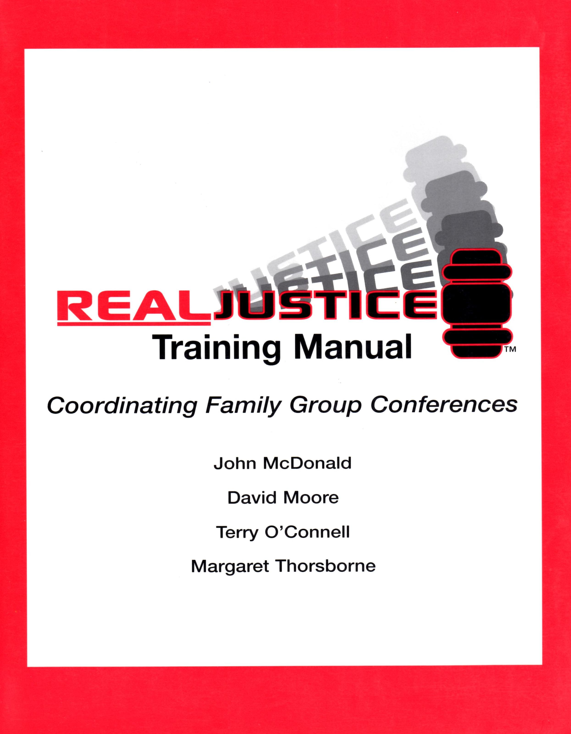
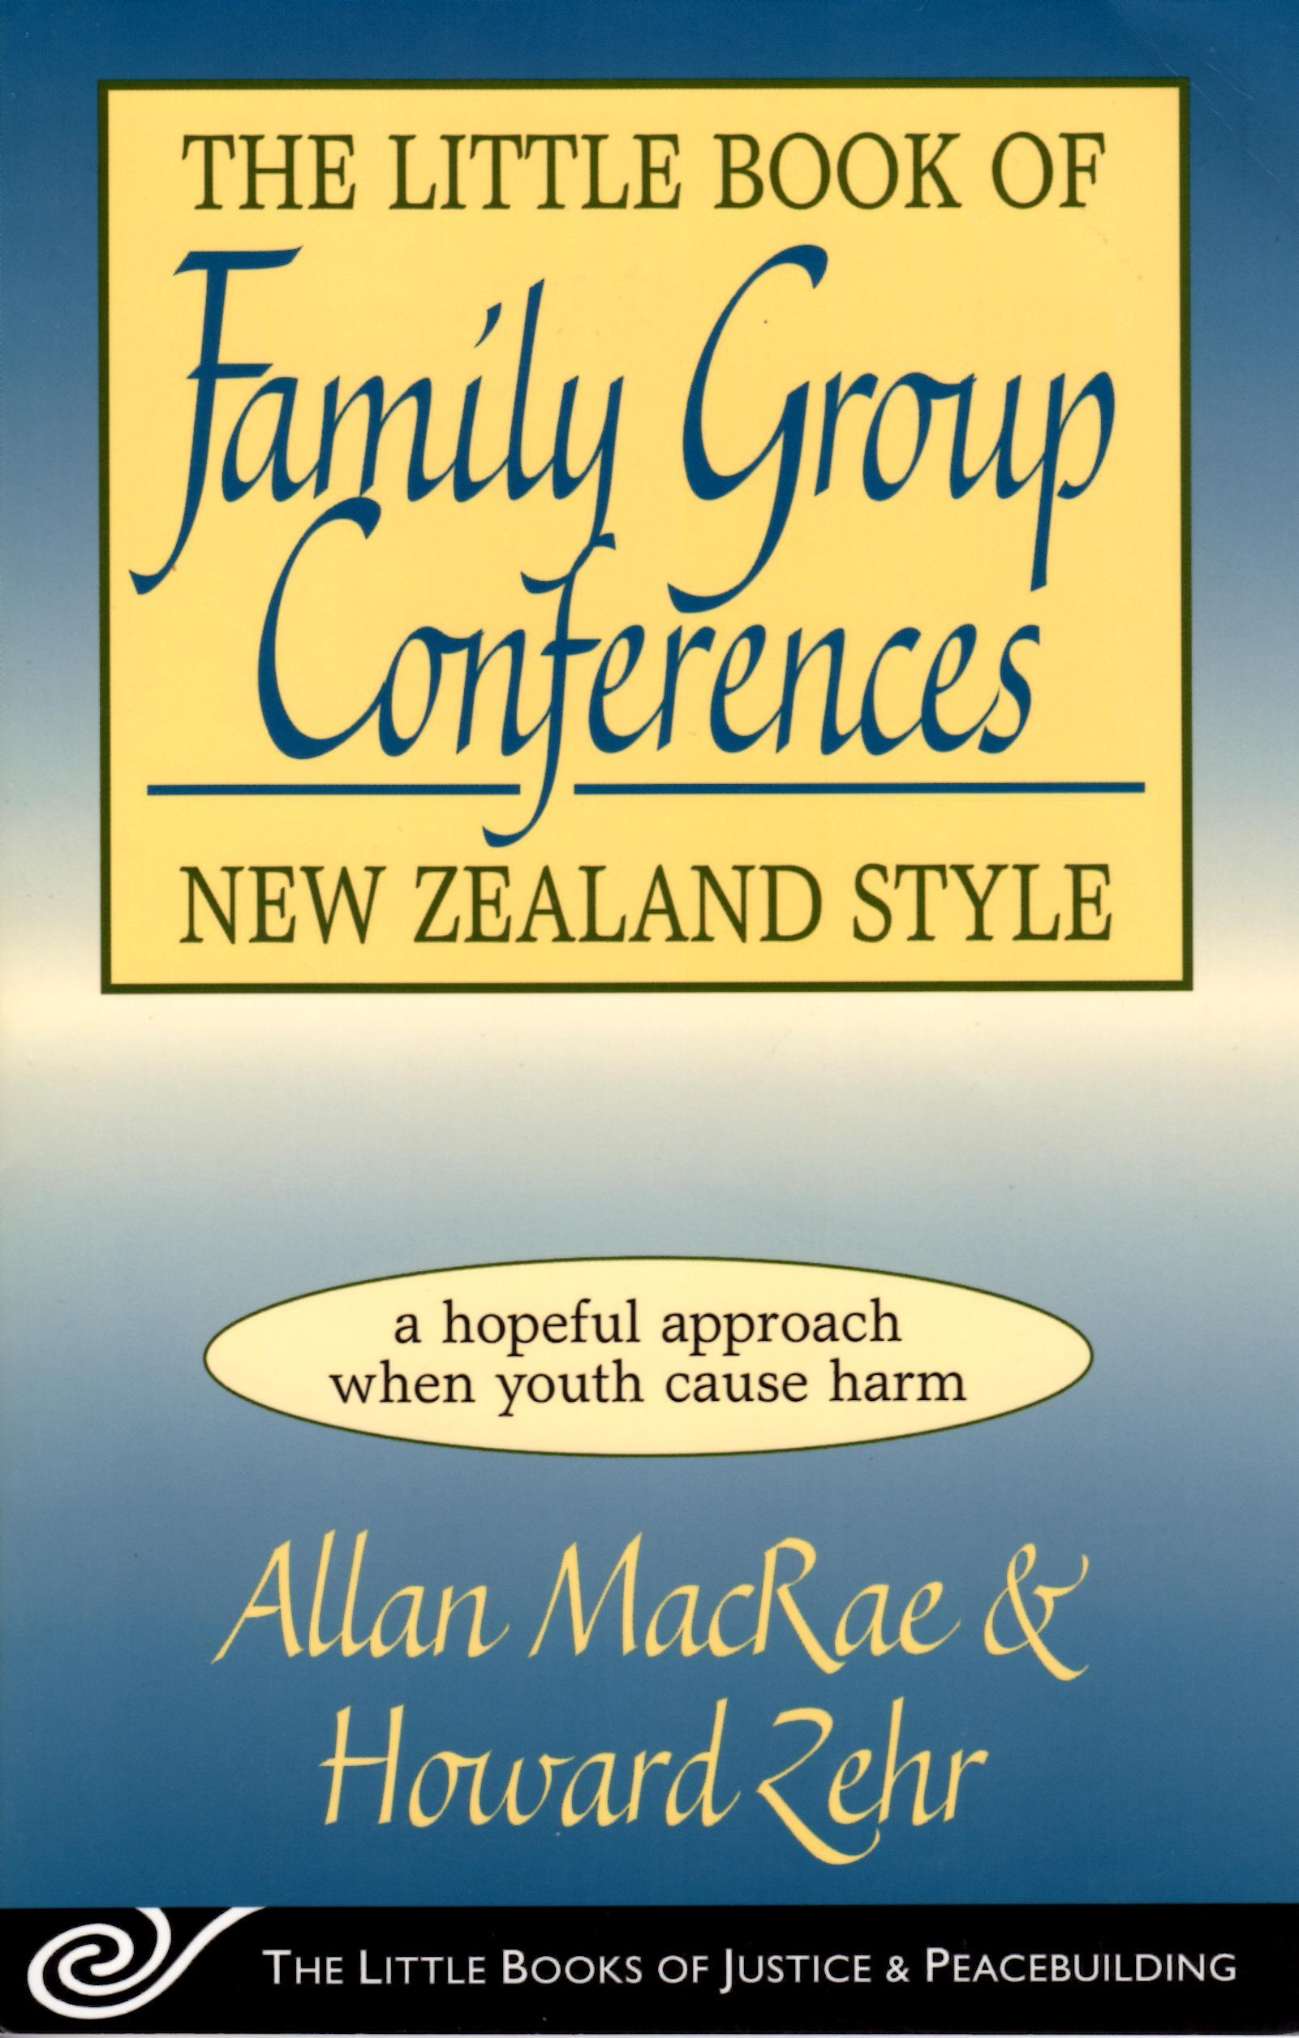
Restorative Justice Practices
Balanced and Restorative Justice
Family Group Conferences
Family Group Decision-Making, 1995 with Montana DPHHS

Slide 9
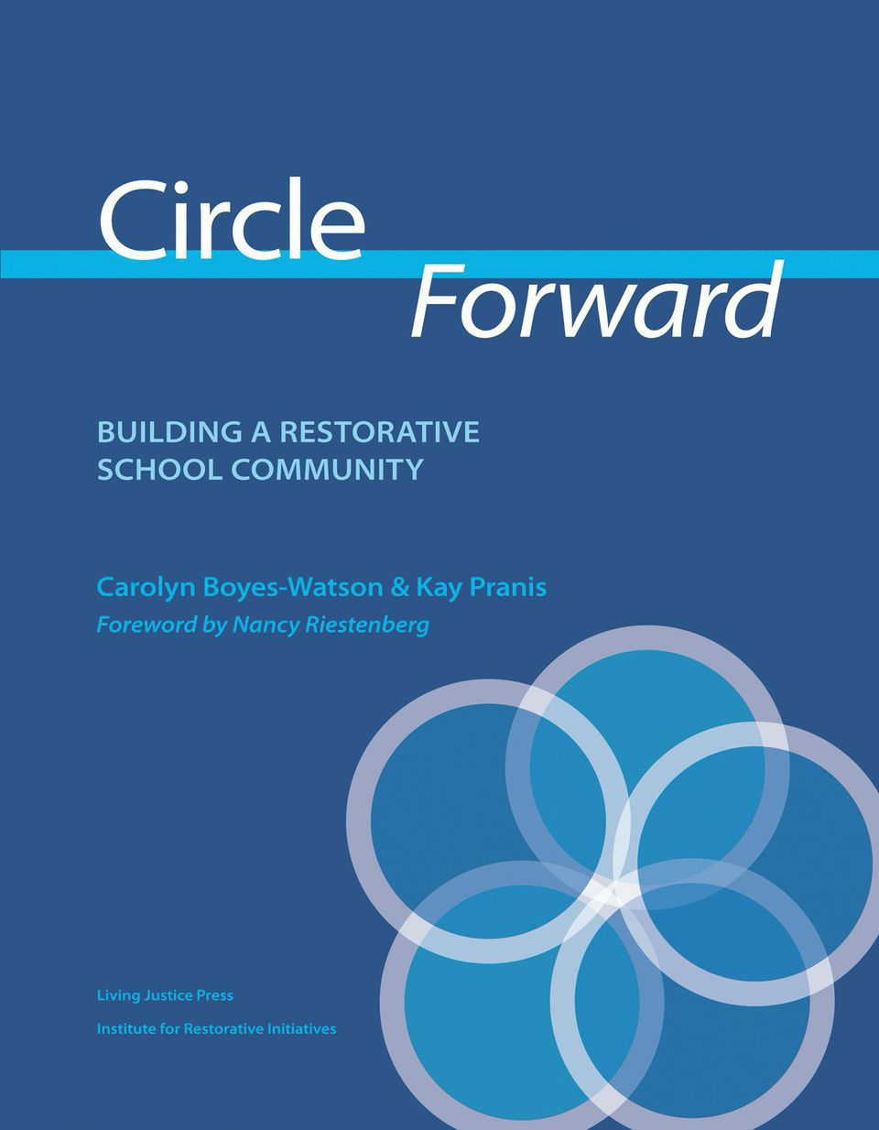
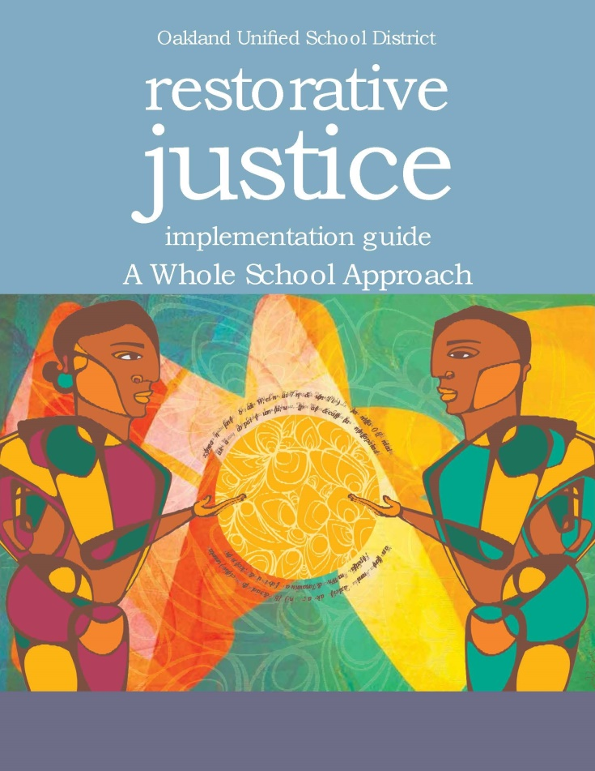
RJ Practices (cont.)
Peacekeeping Circles Restorative Discipline

Slide 10
Shared interest to repair the harm
Offender
Interests
Victim
Interests
Community
Interests
Victim/Offender/
Community

Slide 11
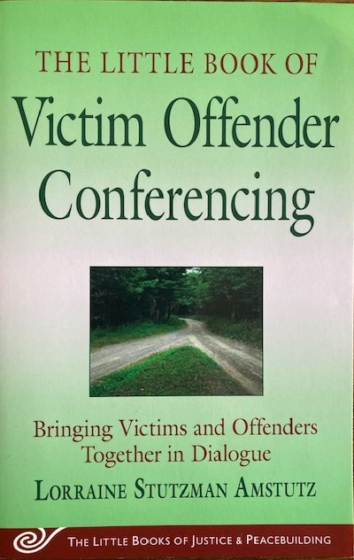
RJ Practices (cont.)
Victim Offender Mediation Dialogue
Victim Offender Conferences
Victim Offender Dialogue

Slide 12
Guiding Principles for Crime Victims and Survivors
Crime is personal
Restorative justice must be victim-centered and trauma-informed
The voices of victims/survivors in restorative justice are integral to its effectiveness and overall success
Victim autonomy must be central to all restorative justice policies and practices
If restorative justice fails to respect and reflect victim’s constitutional and statutory rights, it is not “restorative”
Many justice-involved individuals-including youth, women of color and men- have histories of trauma and victimization that can be addressed and validated within a restorative justice framework
Pavelka, S. & Seymour, A. (2019) Guiding principals and restorative practices for victims and crime survivors. Corrections Today January-February 2019.

Slide 13
What is a Victim Offender Dialogue? Jon Wilson
“Victim Offender Dialogue (VOD) is a process in which the victim of a crime, or the surviving family members, and the offender who committed the offense meet face-to face in a safe and secure setting. For certain victims/survivors of severe violence and violation, the facilitated VOD process can provide a pathway to a sense of further healing and further justice. Though this may not be for every survivor, the experience of talking directly with the offender who committed the violence or violation can enable survivors to give full voice to some of the pain and trauma they have experienced. At the same time, when offenders are able to listen and respond to them, and to give voice to the complexity of feelings about what they have done, they can better understand the devastating effects of their behaviors, and how they came to be capable of such behaviors. With this increased understanding, some offenders will be better able to “account” to the survivor their choices and actions, and will begin to try and make new and purposeful meaning from their experience. The survivors who choose VOD come to feel that they have finally said what they needed to say to the offender. This in itself can be healing for them.”

Slide 14
VOD Program Purpose and Goals
To provide victims of violent crime the opportunity to have a face-to-face meeting with their offender(s) in a secure, safe environment, in order to facilitate a healing, reconstruction/recovery process.
Common goals include providing these opportunities:
For victims to confront the trauma of their victimization;
For victims to ask questions and receive answers and insight that only the offender can provide;
For victims to express directly to the offender current and repressed feelings about the crime;
For victims to experience a sense of empowerment by having a voice and direct participation in the process;

Slide 15
VOD Program Purpose and Goals (cont.)
For offenders to hear first-hand the depth of trauma experienced by the victim;
For offenders to face the full human impact of their crime;
For offenders to honestly answer questions about the crime for the sole purpose helping the victim;
For the offenders to express remorse, develop empathy, and accept full responsibility for the harm cause to the victim and family.
Based on information gathered from program administrators of 18 established state programs https://justalternatives.org/research-project-work/vod-guide-to-best-practices/

Slide 16
The Differences between VOD and Mediation/ADR
Victim Offender Dialogue Mediation/ADR
Victim-centered Neutral or impartial
Trauma informed Not usually
Victim/survivor speaks first Parties decide
Wrong-doing is named Often harm is not considered
Moral imbalance explicitly named Parties morally balanced
Facilitator Mediator
Seeks repair Seeks agreement
Extensive preparation & follow-up Little or no separate preparation
Relationship focused Outcome-focused
Victim empowerment Participant fairness

Slide 17
The Victim Offender Dialogue Process
Referral (victim/survivor initiated in serious cases)
Logging, screening and case management
Preparation and initial meetings
First contact with offender (eligibility) and admission of guilt
Mental health screening
Preparation meetings timeline
The VOD meeting
Reporting and debriefing
Follow-up

Slide 18
The VOD Dialogue
Dialogue set-up
Time frame of one day
Safe, secure location
Presence of support people
Dialogue
Opening statement, purpose, ground rules
Victim given the choice to speak first
Storytelling: What happened? How did it affect you?
Offender to demonstrate accountability
Exploring how to repair harm
Agreement
Closing the dialogue & evaluations

Slide 19
Debrief of VOD Role Play
How are you doing/feeling?
How was the dialogue different than what you expected?
Wes there anything else you wish had occurred?
What would you say was the most difficult part of the dialogue?
When you listened to the (offender) (victim), how did it affect you?
Was there anything you felt unprepared for?
Are there any remaining issues or needs that you would like to see addressed?
What good can come out of this, if any?
What is your plan for self-care this afternoon, tonight, tomorrow?
When can I be in touch with you in the next few days to check in?
From Minnesota DOC Restorative Justice Unit

Slide 20
Restorative Justice Reading List
Boyes-Watson, C. and Pranis, K. (2010) Heart of Hope Resource Guide: Using Peacemaking Circles to Develop Emotional Literacy, Promote Healing, and Building Relationships. St Paul: Living Justice Press
Boyes-Watson, C. and Pranis, K. (2020) Circle Forward: Building a Restorative School Community, Revised Edition. St Paul: Living Justice Press.
Davis, F. E. (2019). The Little Book of Race and Restorative Justice: Black Lives, Healing, and US Social Transformation. New York: Good Books.
Karp, D.R. (2015). The Little Book of Restorative justice for Colleges and Universities: Repairing Harm and Rebuilding Trust in Response to Student Misconduct. New York: Good Books.
Hass-Wisecup, A.Y. and Saxon, C.E. (2021). Restorative Justice: Integrating Theory, Research, and Practice 2nd Edition. Durham, North Carolina: Carolina Academic Press.
.

Slide 21
Restorative Justice Reading List
Herman, J. L. (1992). Trauma and Recovery. New York: Basic Books
Herman, J. L. (2023) Truth and Repair: How Trauma Survivors Envision Justice. New York: Basic Books
Miller, S.L. (2011). After the Crime: The Power of Restorative Dialogues Between Victims and Violent Offenders. New York: New York University Press.
Neilsen, M. O. and Zion, J. W. (eds.) (2005) Navajo Nation Peacemaking: Living Traditional Justice. Tucson: University of Arizona Press.
O’Connell, T., Wachtel, B. and Wachtel, T. (1999) Conferencing Handbook: The New Real Justice Training Manual. Pipersville, PA: Piper’s Press.

Slide 22
Restorative Justice Reading List
Oudshoorn, J., Jackett, M. and Stutzman-Amstutz, L. (2015). The Little Book of Restorative Justice for Sexual Abuse: Hope through Trauma. New York: Good Books.
Sered, D. (2019) Until We Reckon: Violence, Mass Incarceration and a Road to Repair. New York: The New Press.
Stutzman Amstutz, L. (2009). The Little Book of Victim Offender Conferencing: Bringing Victims and Offenders Together in Dialogue. New York: Good Books.
Van Ness, D.W., Heetderks Strong, K., Derby, J., and Parker, L. L. (2022) Restoring Justice: An Introduction to Restorative Justice 6th Edition. New York: Routledge
Zehr, H. (1990). Changing Lenses: A New Focus for Crime and Justice. Huntington, Indiana: Herald Press.
Zehr, H. (2015) The Little Book of Restorative Justice: Revised and Updated. New York: Good Books.
Zehr, H. (2023). Restorative Justice: Insights and Stories from My Journey. Lancaster, PA: Walnut Street Books.

Slide 23
Restorative Justice Links
National Association of Community and Restorative Justice https://nacrj.org
International Institute for Restorative Practices www.iirp.edu
Kempe Center on Child Abuse and Neglect https://medschool.cuanschutz.edu/pediatrics/sections/child-abuse-and-neglect-(kempe-center)/training-and-consultation/professional-development-in-fgdm
RestoreJustice.com California Catholic Conference https://www.cacatholic.org/restorejustice/
Boulder County District Attorney (nd). Trauma-informed Restorative Practices. Center for Prevention and Restorative Justice. Available at https://geiselmed.dartmouth.edu/ofa/wp-content/uploads/sites/56/2021/01/Trauma-Informed-Restorative-Practices-HANDOUT.original.1560403245-2.pdf

Slide 24
Restorative Justice More Links
Pavelka, S. & Seymour, A. (2019) Guiding principles and restorative practices for crime victims and survivors. Corrections Today January-February 2019. Available at https://www.aca.org/common/Uploaded%20files/Publications_Carla/Docs/Corrections%20Today/2019%20Articles/Guiding-Principles-and-Restorative-Practices-for-Crime_Victims-and-Survivors.pdf
Just Alternatives, Jon Wilson https://justalternatives.org/
Oakland Unified School District (2016) .Restorative Justice Implementation Guide: A Whole School Approach. Available at https://resources.finalsite.net/images/v1692101675/ousdorg/mxzgprfq2ic2oq4ethyv/BTC-OUSD1-IG-08b-web.pdf
YouTube RJ Playlist: Lee Copenhagen, LCSW https://www.youtube.com/channel/UCya-XZshCC1snY3sw2ZLgSw/playlists
Lee Copenhagen https://cojustice.org

